Slide 1
Global Terrorism Analysis
By Khushi Kansara

Slide 2
Overview
The goal of this analysis is to provide comprehensive and informative dashboard that visualizes global terrorism trend and patterns.
Insights:
Rate By Type of attack
Rate By Target Type
Rate By Weapons Type
Rate By Group Name
Maximum Attack By Year
Slicer : Countries
Cards: Total Attack, Most Deadly Group, Total Targets, Most Used Weapons

Slide 3
Interactive Dashboard

Slide 4
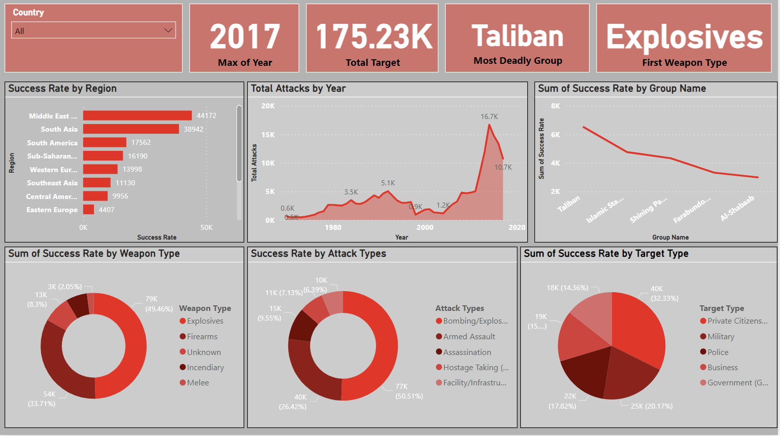

Slide 5
Recommendations
Promoting peace and development in conflict-prone areas.
Strengthening international cooperation on counter-terrorism.
Countering terrorist propaganda and ideology.
Protecting vulnerable populations.

Slide 6
Thank You !

